Slide 1
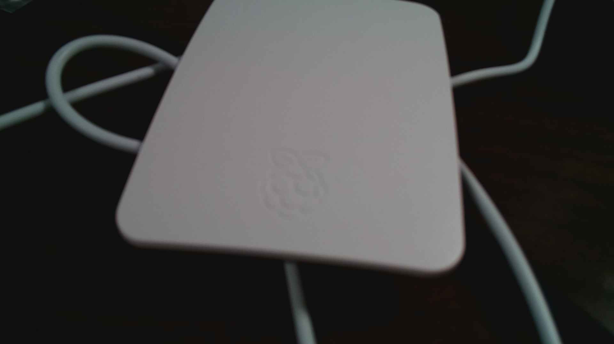
화면캡쳐 Python 코드
from picamera import PiCamera
from time import sleep
camera = PiCamera()
camera.start_preview()
sleep(10) #10초동안 보여줍니다.
camera.capture(‘저장할위치’)
#camera.capture('/home/pi/Desktop/10261.jpg')
#캡처하여 원하는 위치에 캡처파일 저장
camera.stop_preview()

Slide 2
참고자료
https://blog.naver.com/icbanq/220932240604
https://projects.raspberrypi.org/en/projects/getting-started-with-picamera

